Slide 1



Electricity Demand and Price Forecasting
This presentation explores the power of predictive analytics to forecast electricity demand and pricing trends, enabling data-driven decisions that optimize the grid, reduce costs, and enhance energy trading strategies.
by Nikhil

Slide 2

Objective and Relevance
Objective
Relevance
Predict electricity demand and price trends using historical data.
Supports grid management, cost optimization, and energy trading strategies.

Slide 3

Data Overview
1
Data Source
2
Key Features
Public electricity consumption and pricing datasets.
Time-stamped electricity prices (hourly/daily).
3
Key Features
4
Key Features
Demand metrics (megawatt-hour consumption).
Influencing factors: weather, holidays, economic indicators.

Slide 4

Forecasting Methodology
1
Data Preprocessing
Clean, normalize, and aggregate the raw data.
2
Feature Engineering
Identify and extract relevant predictive features.
3
Modeling
Apply machine learning algorithms to forecast demand and prices.
4
Evaluation
Assess model performance and refine the approach.

Slide 5
Demand Forecasting
Approach
Benefits
Use time series analysis and neural networks to predict hourly/daily electricity consumption.
Enables efficient grid planning, capacity management, and optimization of energy resources.

Slide 6
Price Forecasting
Approach
Benefits
Leverage market factors, weather data, and historical pricing patterns to predict electricity prices.
Supports cost-effective energy procurement and trading strategies.

Slide 7

Case Study: Optimizing Energy Portfolios
Improved Grid Resilience
Cost Savings
Accurate price predictions enable energy consumers to optimize their procurement strategies.
Forecasting models help utilities anticipate and respond to demand spikes, reducing the risk of outages.
Enhanced Trading
Traders can leverage forecasts to identify arbitrage opportunities and manage risk in the energy markets.

Slide 8
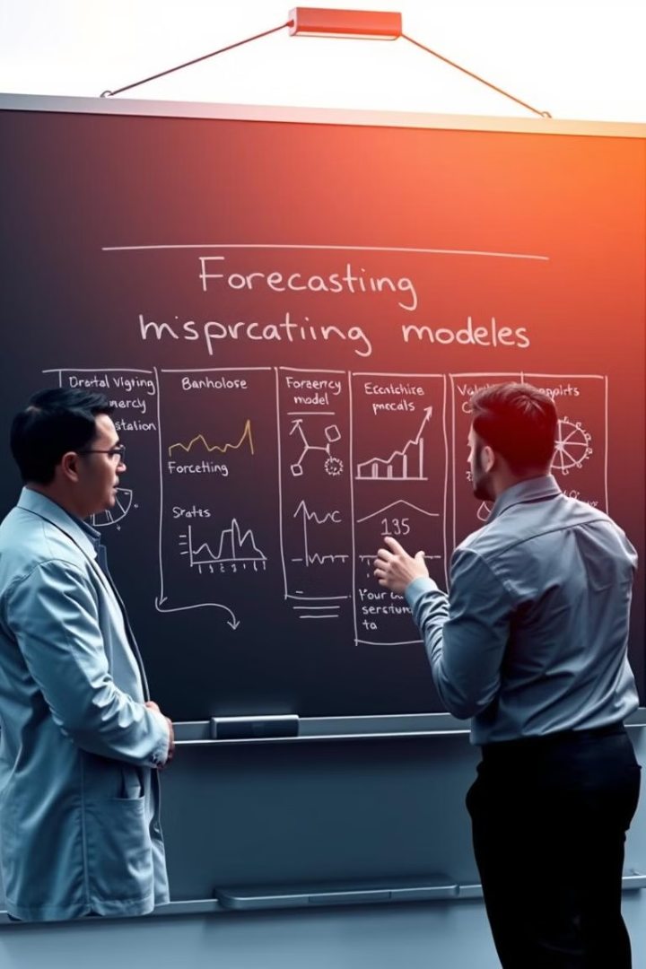
Key Takeaways
Predictive Insights
Operational Optimization
Electricity demand and price forecasting models provide critical insights to support data-driven decision-making.
Accurate forecasts enable utilities, consumers, and traders to optimize grid operations, energy procurement, and market strategies.
Continuous Improvement
Ongoing model refinement and integration of new data sources can further enhance the accuracy and utility of these forecasting tools.

